Slide 1

Gov 2.0 Summit
2009 Nextgov Audience Survey
April 15th, 2009
Marketer Name

Slide 2

Designed for the Web.
Launched March 2008 to cover the strategic use of information technology in the federal government.
  Daily News
  Interaction
  Resources
  Aggregation
  Blogs

Slide 3

Seven months later:
“Tech president” elected
Notes:
3

Slide 4
Seven months later:
“Tech president” elected
Two months later:
Issues Day One memos
Includes call for open
government directive
Notes:
4

Slide 5
Seven months later:
“Tech president” elected
Two months later:
Issues Day One memos
Includes call for open
government directive
One month later:
Names Earl DeVaney
head of RAT Board
Notes:
5

Slide 6
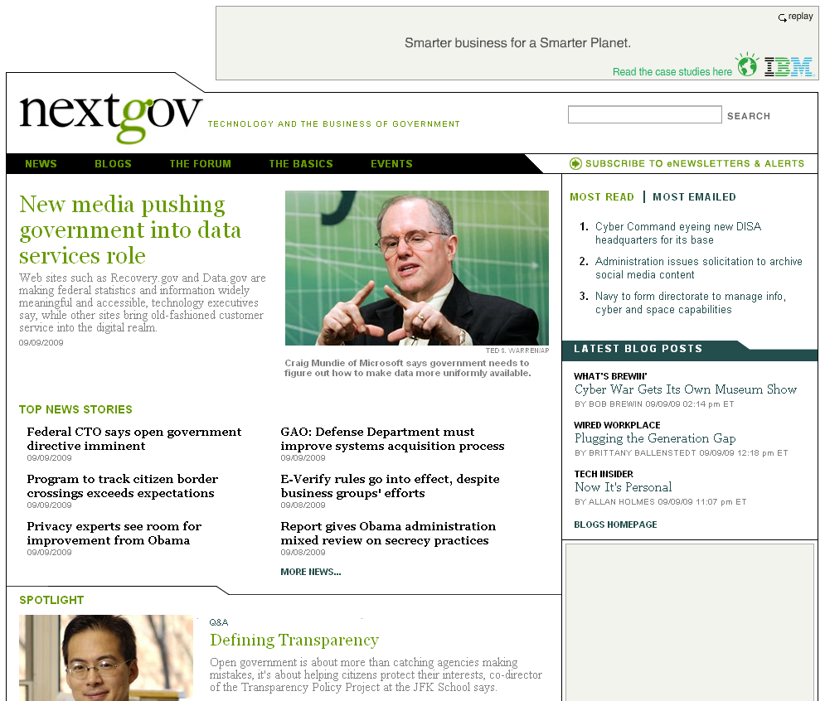

Slide 7
Best of the Web: An Analysis
Most federal Web sites “brochureware”
Agency-centric vs. customer-centric
Static
But

Slide 8
Best of the Web: An Analysis
Sites that scored consistently high in customer satisfaction:
  SSA
  Library of Congress
  NASA
  CDC
  TSA
Notes:
8

Slide 9
Best of the Web: An Analysis
Gov 2.0 experts in and outside government said:
  Organize content for the public
  Rely on (and don’t fear) Web 2.0
  Listen (and respond) to user needs
  Know visitors come to conduct specific tasks
  Engage customers with candid, well written blogs
Notes:
9

Slide 10
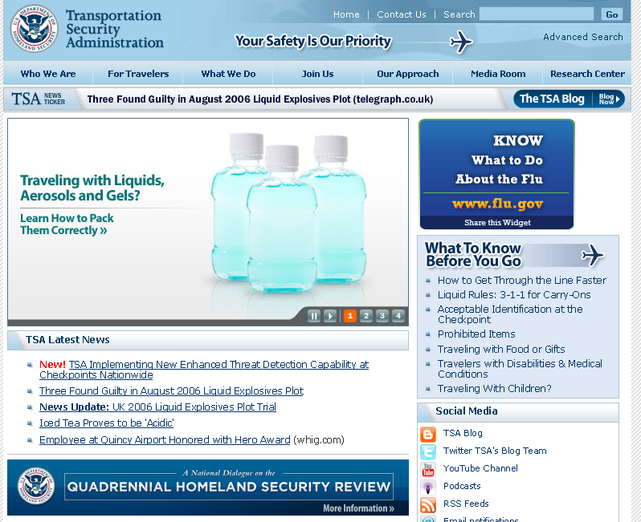

Slide 11
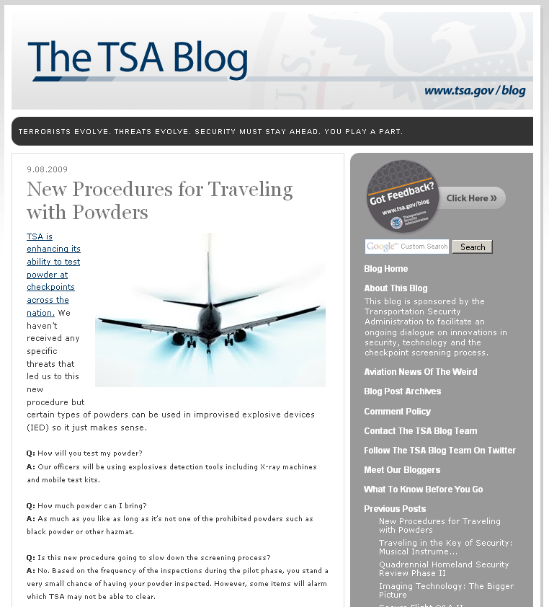

Slide 12
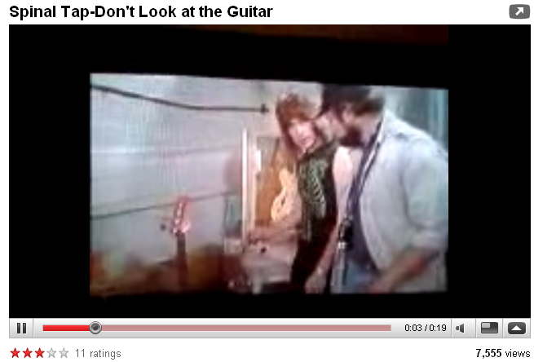
TSA.gov
The TSA Blog
Written in conversational tone
Entertaining, yet provides useful
information
Engages audience
Dozens of comments per post
Notes:
12

Slide 13
Sample TSA Blog Comments
“Except the problem . . . is that the image of a person's body will be visible to TSA screeners standing just feet away. It's none of TSA's business whether I have a nipple ring or a colostomy bag, or what the outline of my private parts looks like. That has nothing to do with the security of air transportation.”
“Security seems to be the all-purpose blanket excuse for justifying, evading, and covering up all manner of incompetence, failure, and abuse. The TSA has taken the lead in employing this pernicious practice, and refined it into an exquisite institutional art.”
“First, it is confiscation. Stop lying to us. Or do your regulations tell you to tell us it's not confiscation? What paragraph and section say ‘You will never refer to confiscation as confiscation, only as “voluntary surrender”’? Or is that information secret like the answer to every other non-sensical rule?
Notes:
13

Slide 14
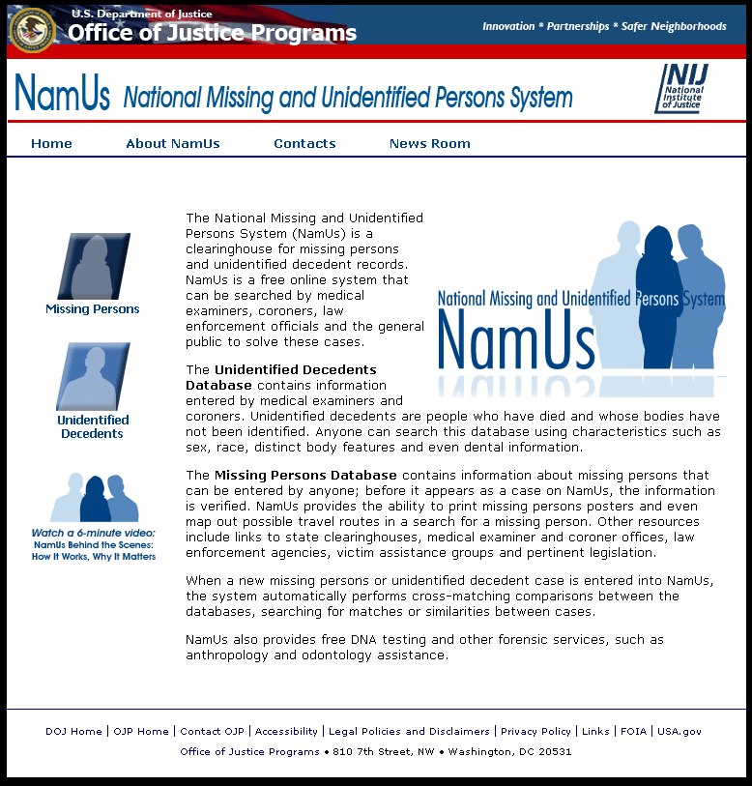

Slide 15
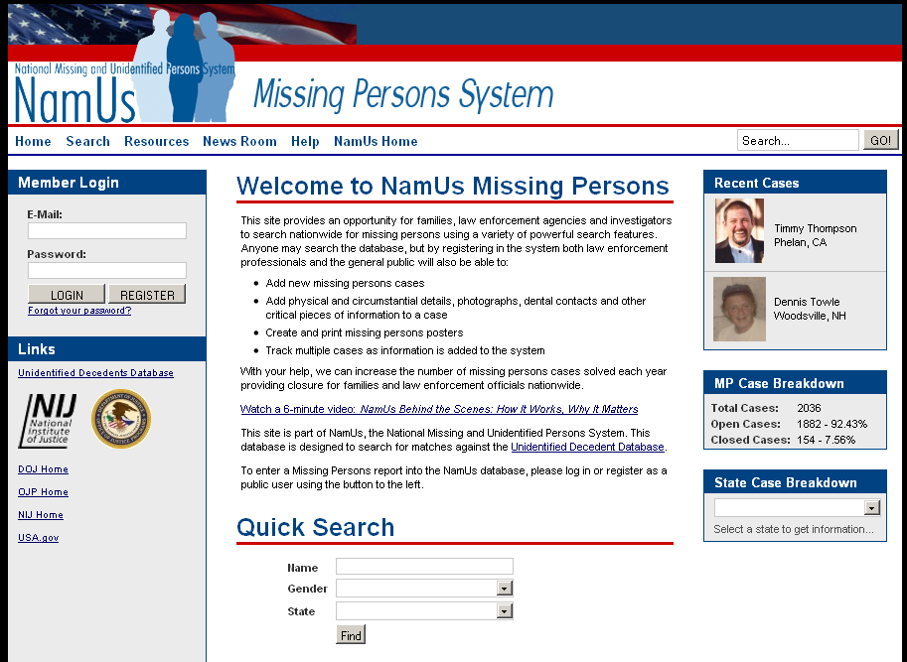

Slide 16
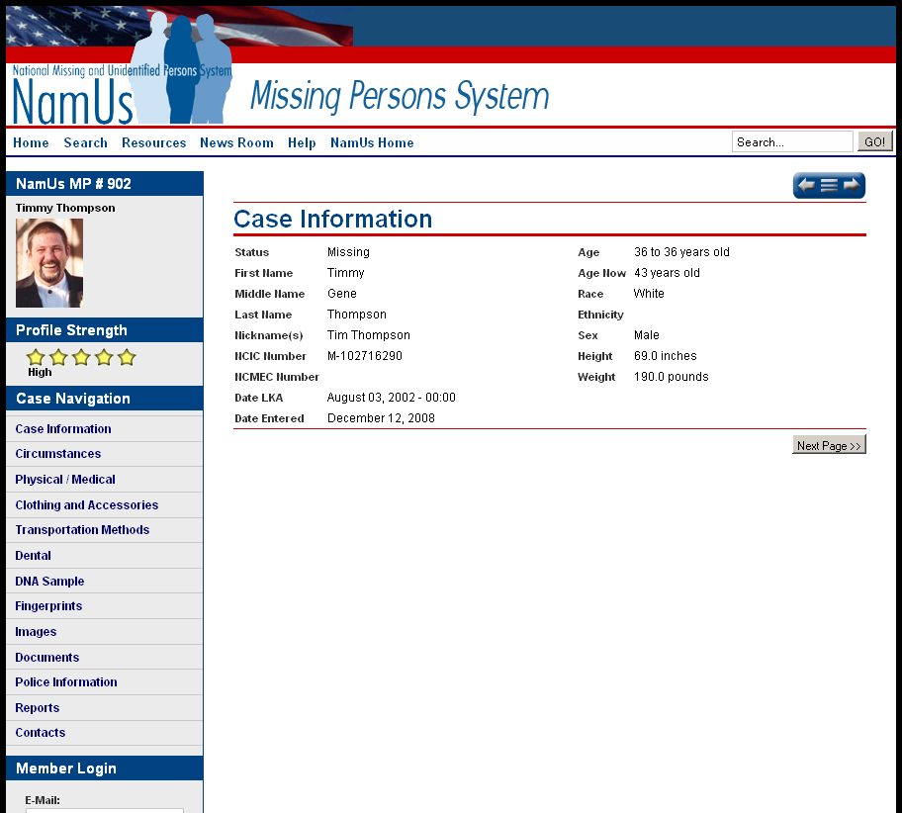

Slide 17
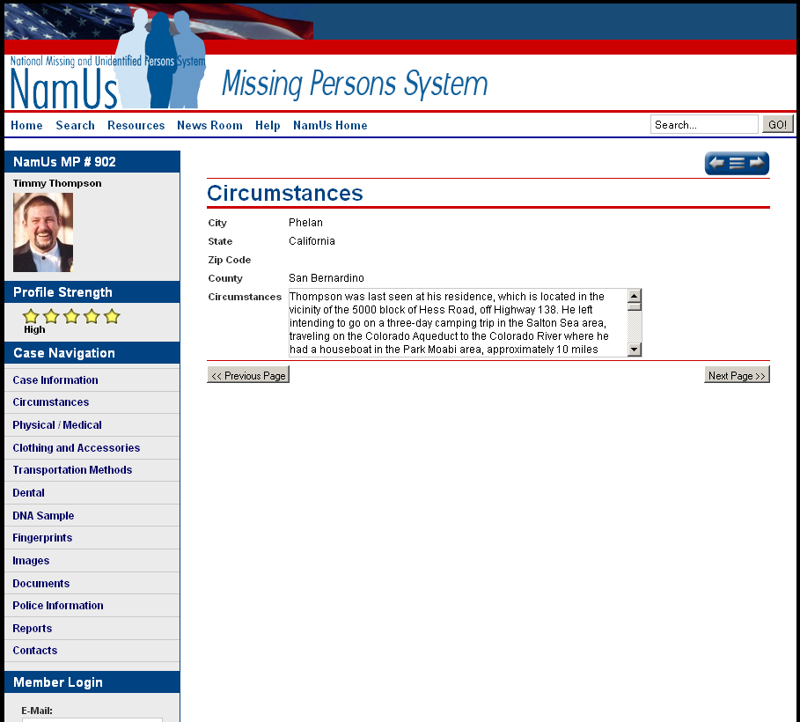

Slide 18
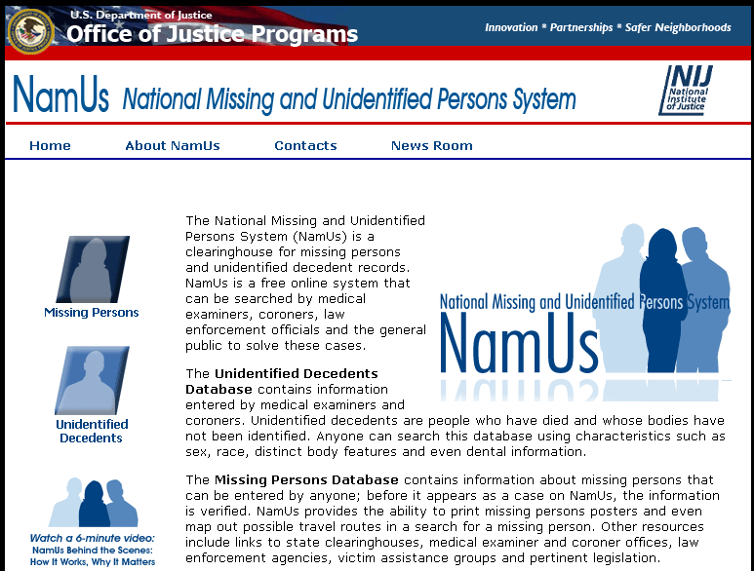
NAMUS
5,225 descriptions of remains.
1,772 missing persons cases.
Automatic alerts sent when missing persons’ profiles match descriptions.
Notes:
18

Slide 19
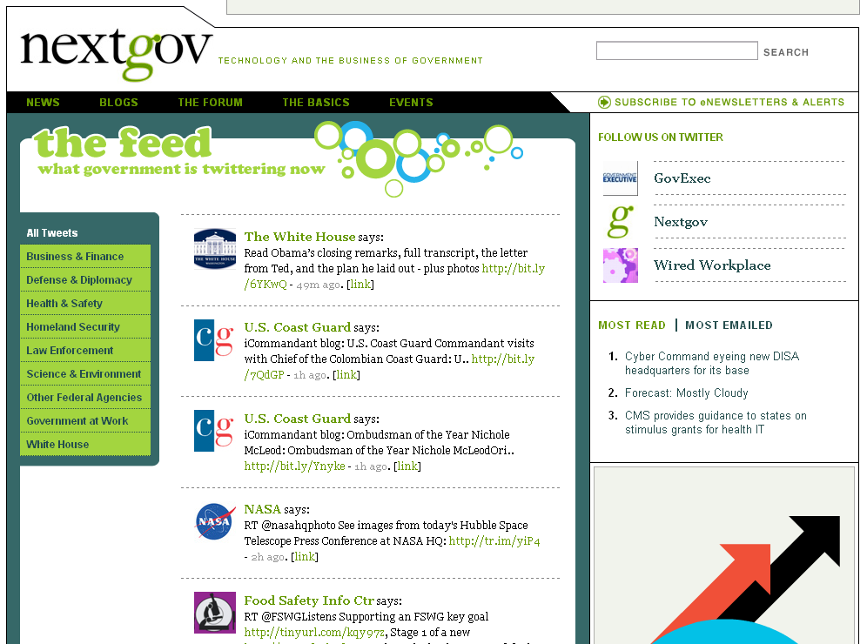

Slide 20

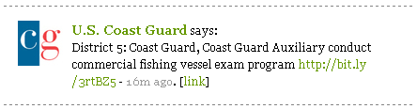
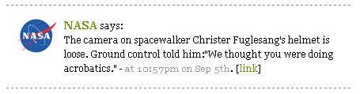
Feds on Twitter
Notes:
20

Slide 21
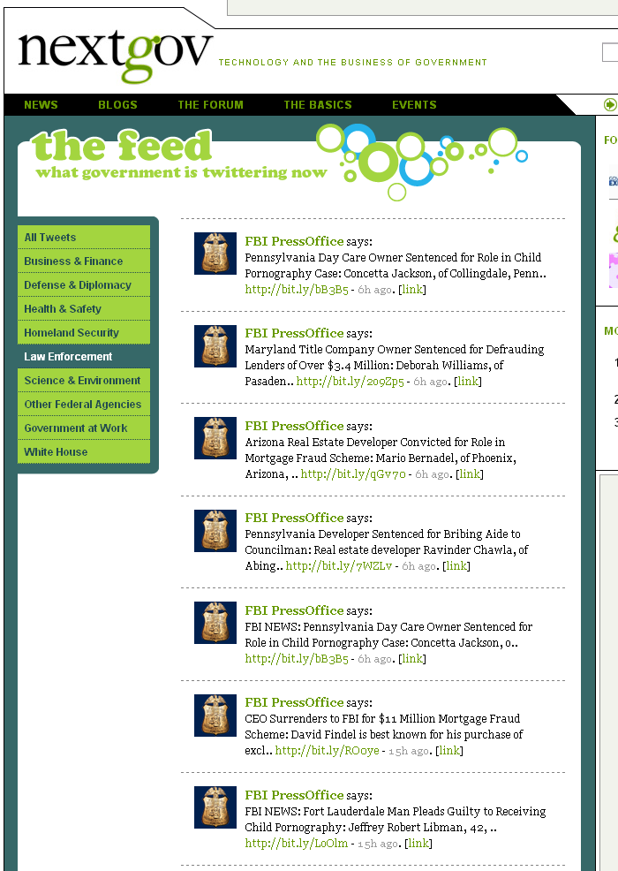

Slide 22
Thank You.

